Slide 1
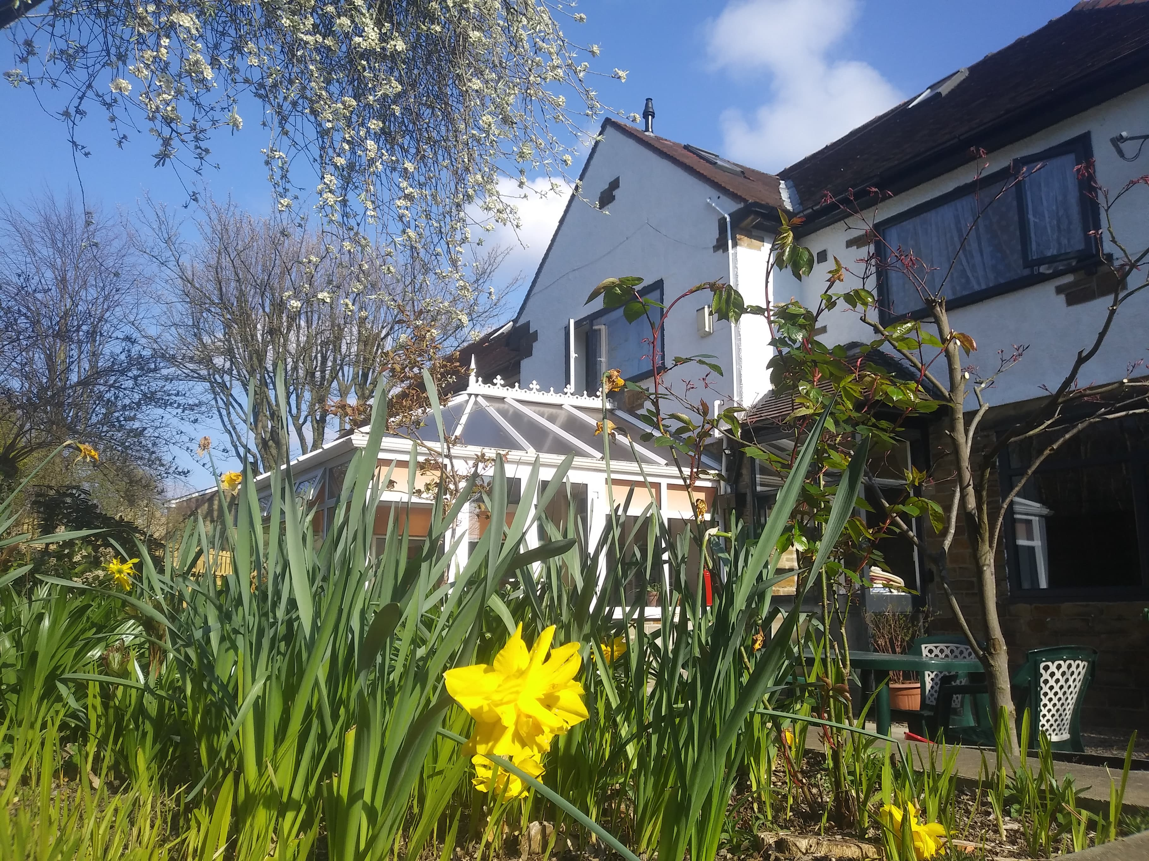


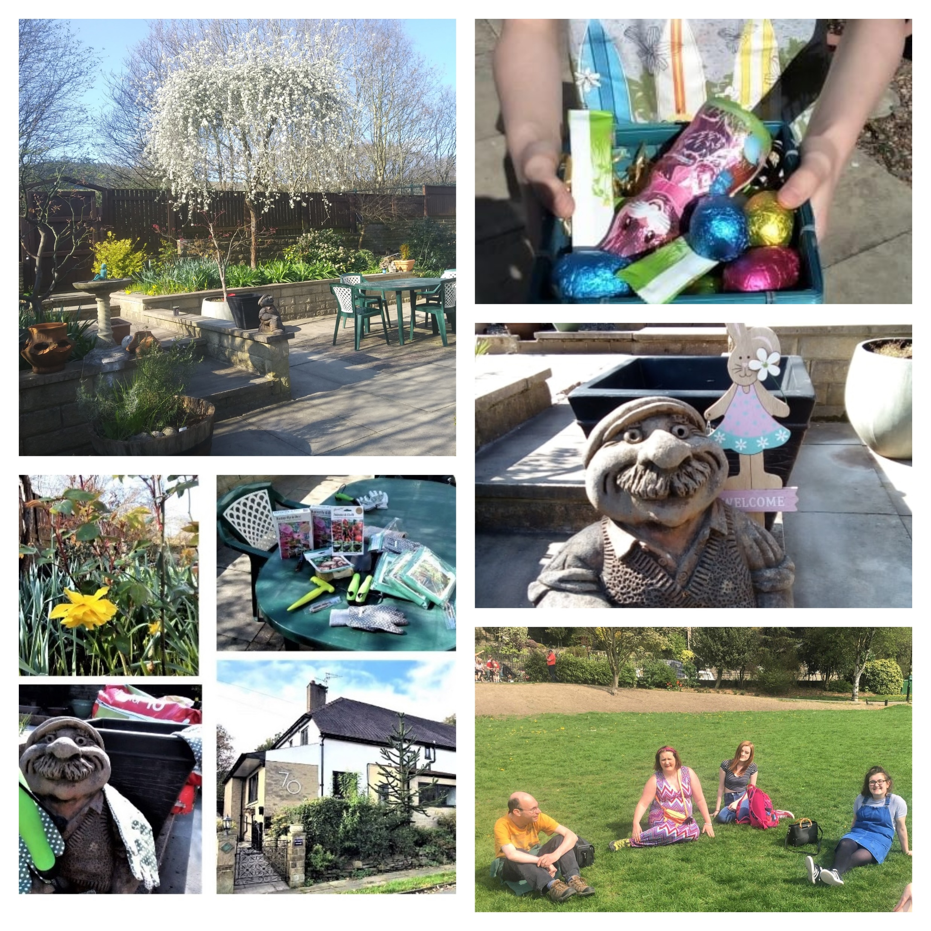
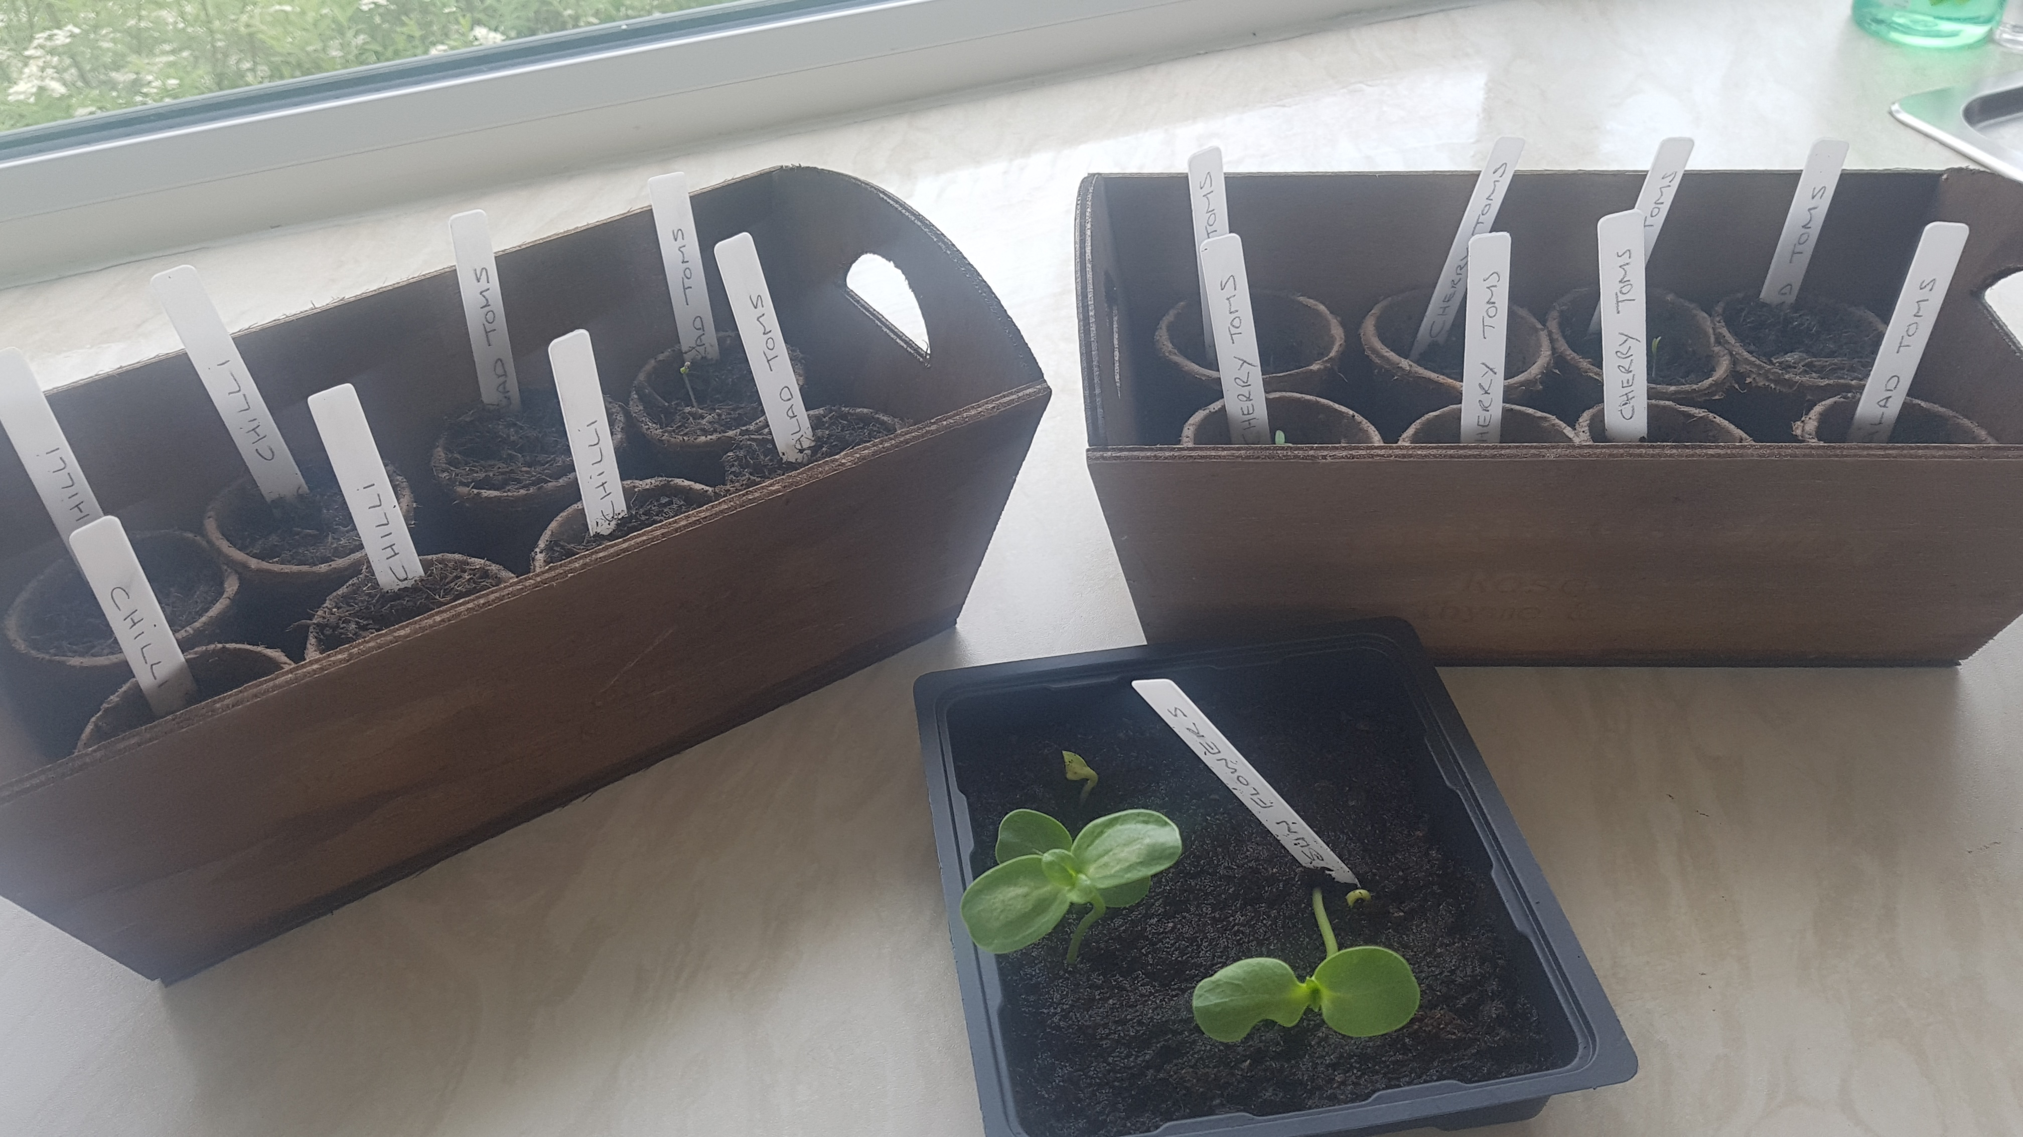

Welcome to our
1st Monthly Newsletter!
April 2019
Silver Birches is a Supported Living home run by Welcome Independent Living. With many years experience our friendly team at Silver Birches pride themselves on offering a highly professional care service for adults, with an approach that focuses on seeing each person as an individual and empowering them to maximise their independence.
Easter Fun
Our tenants thoroughly enjoyed the Easter Bank Holiday especially as it didn’t rain!
Some of them took part in an Easter egg hunt in our garden. They then enjoyed a barbecue in the afternoon sun.
The weekend was finished off by cheering on the duck race in Hebden Bridge followed by a picnic in the park.
Our tenants have also been busy this month planting seeds for our fruit and vegetable garden. They are doing a fantastic job of keeping them watered!

Slide 2
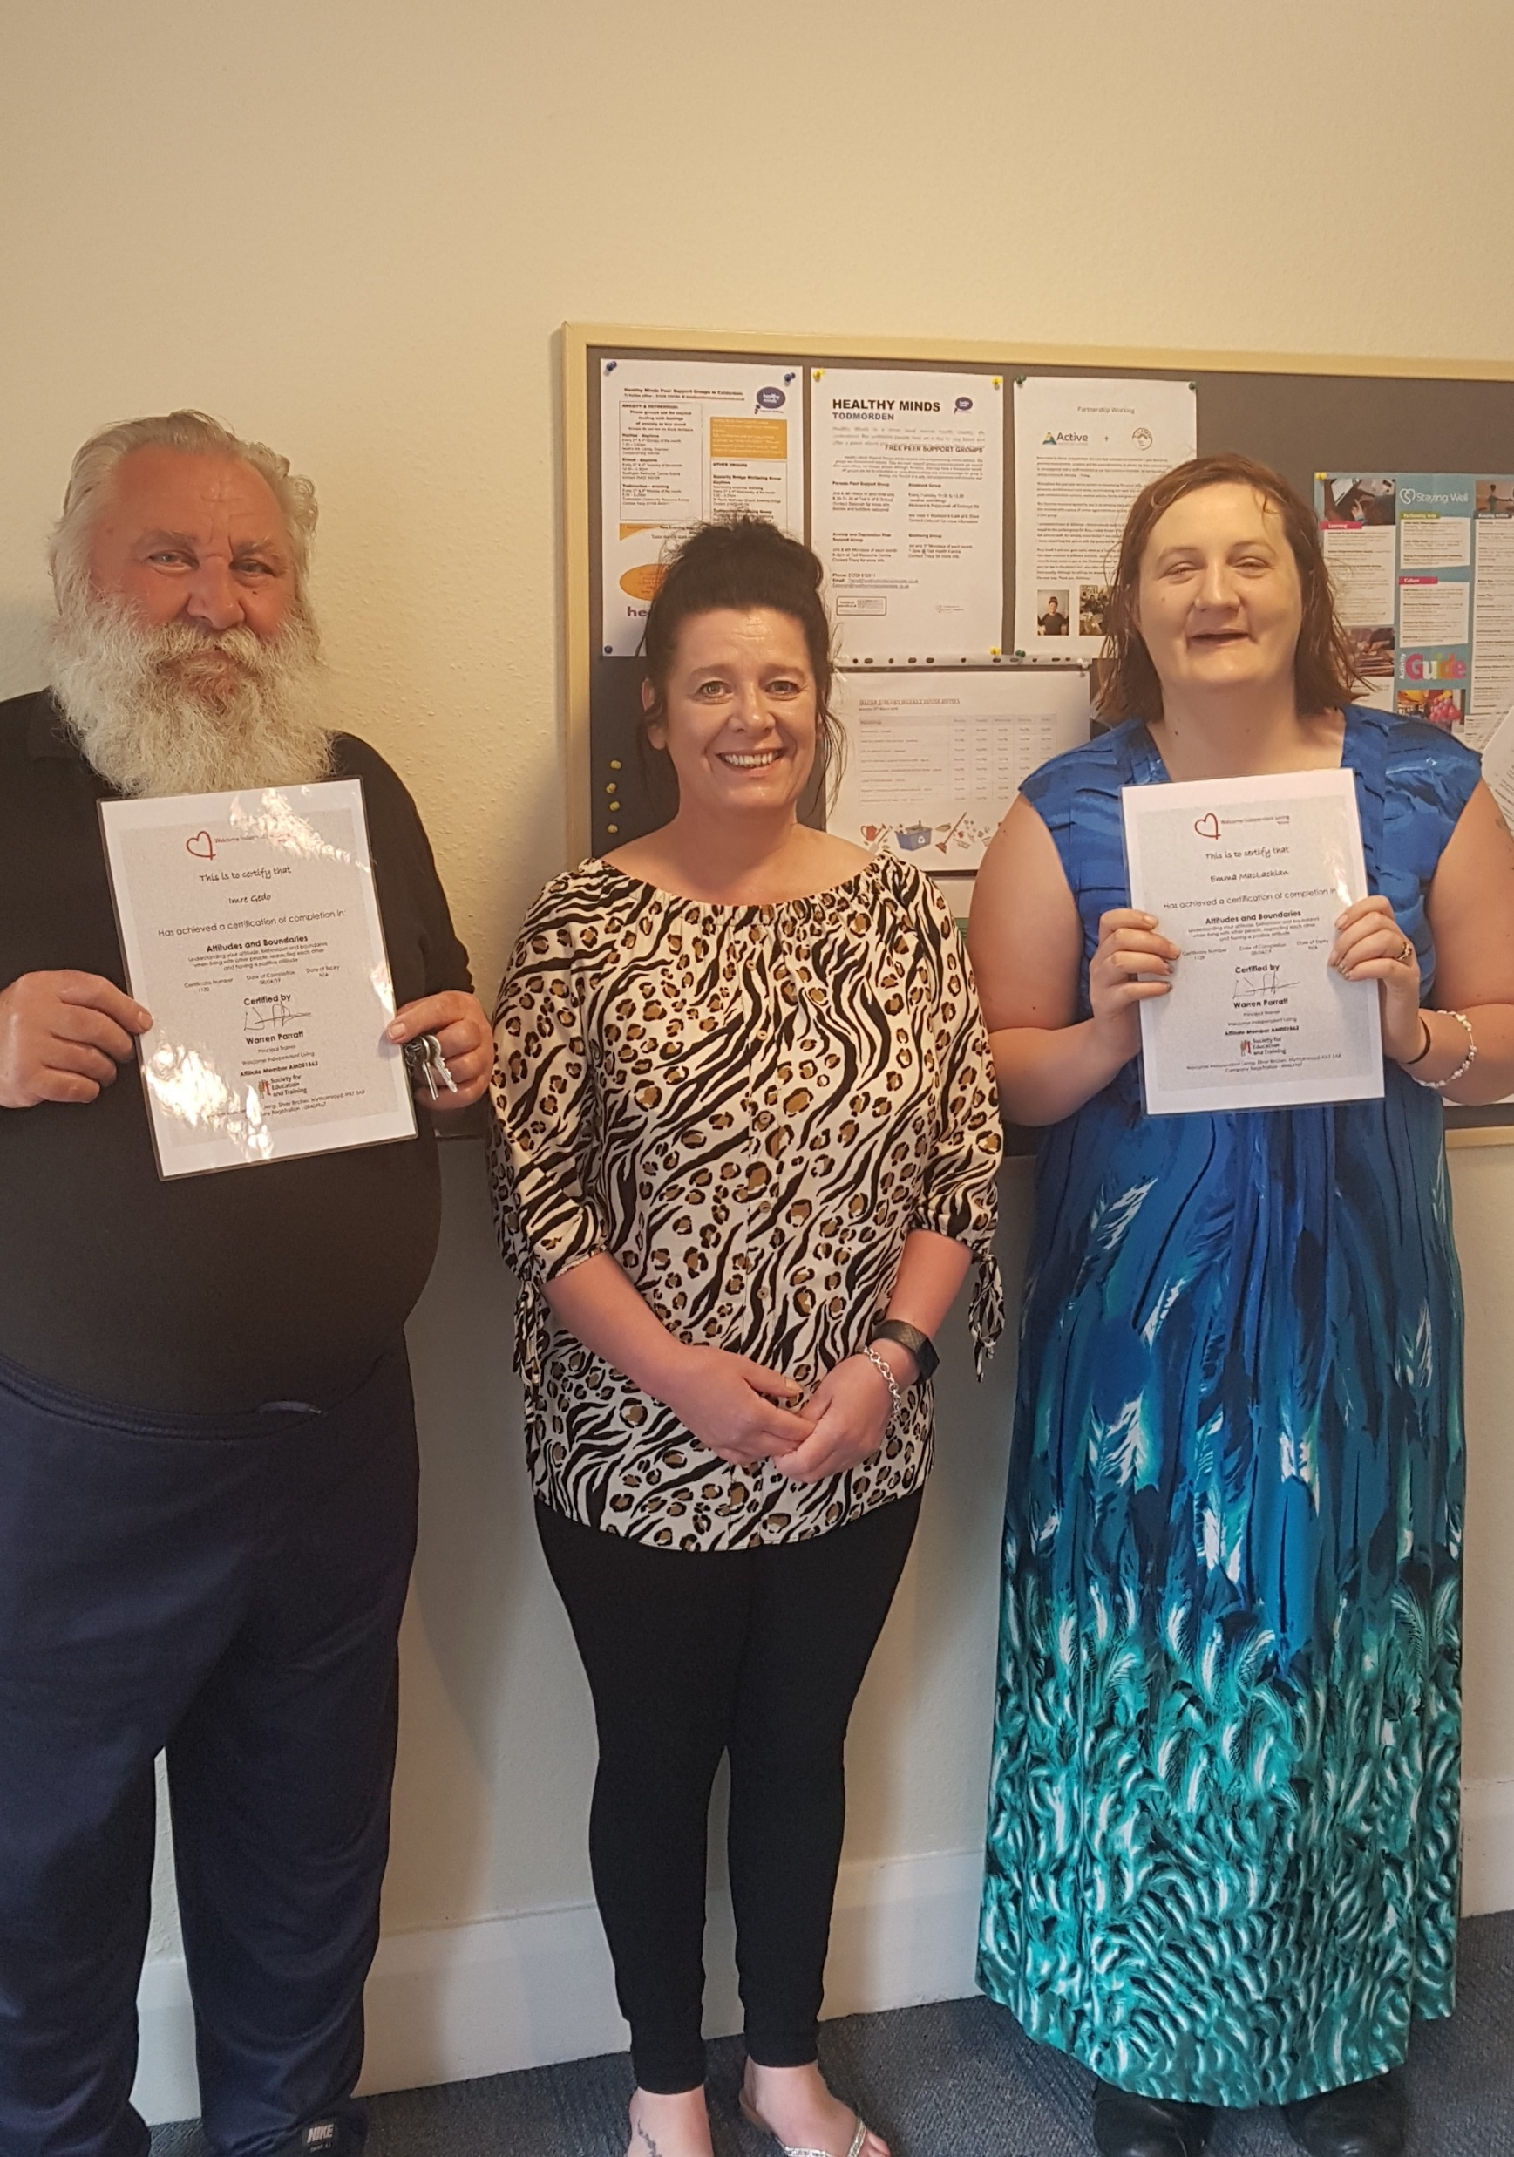

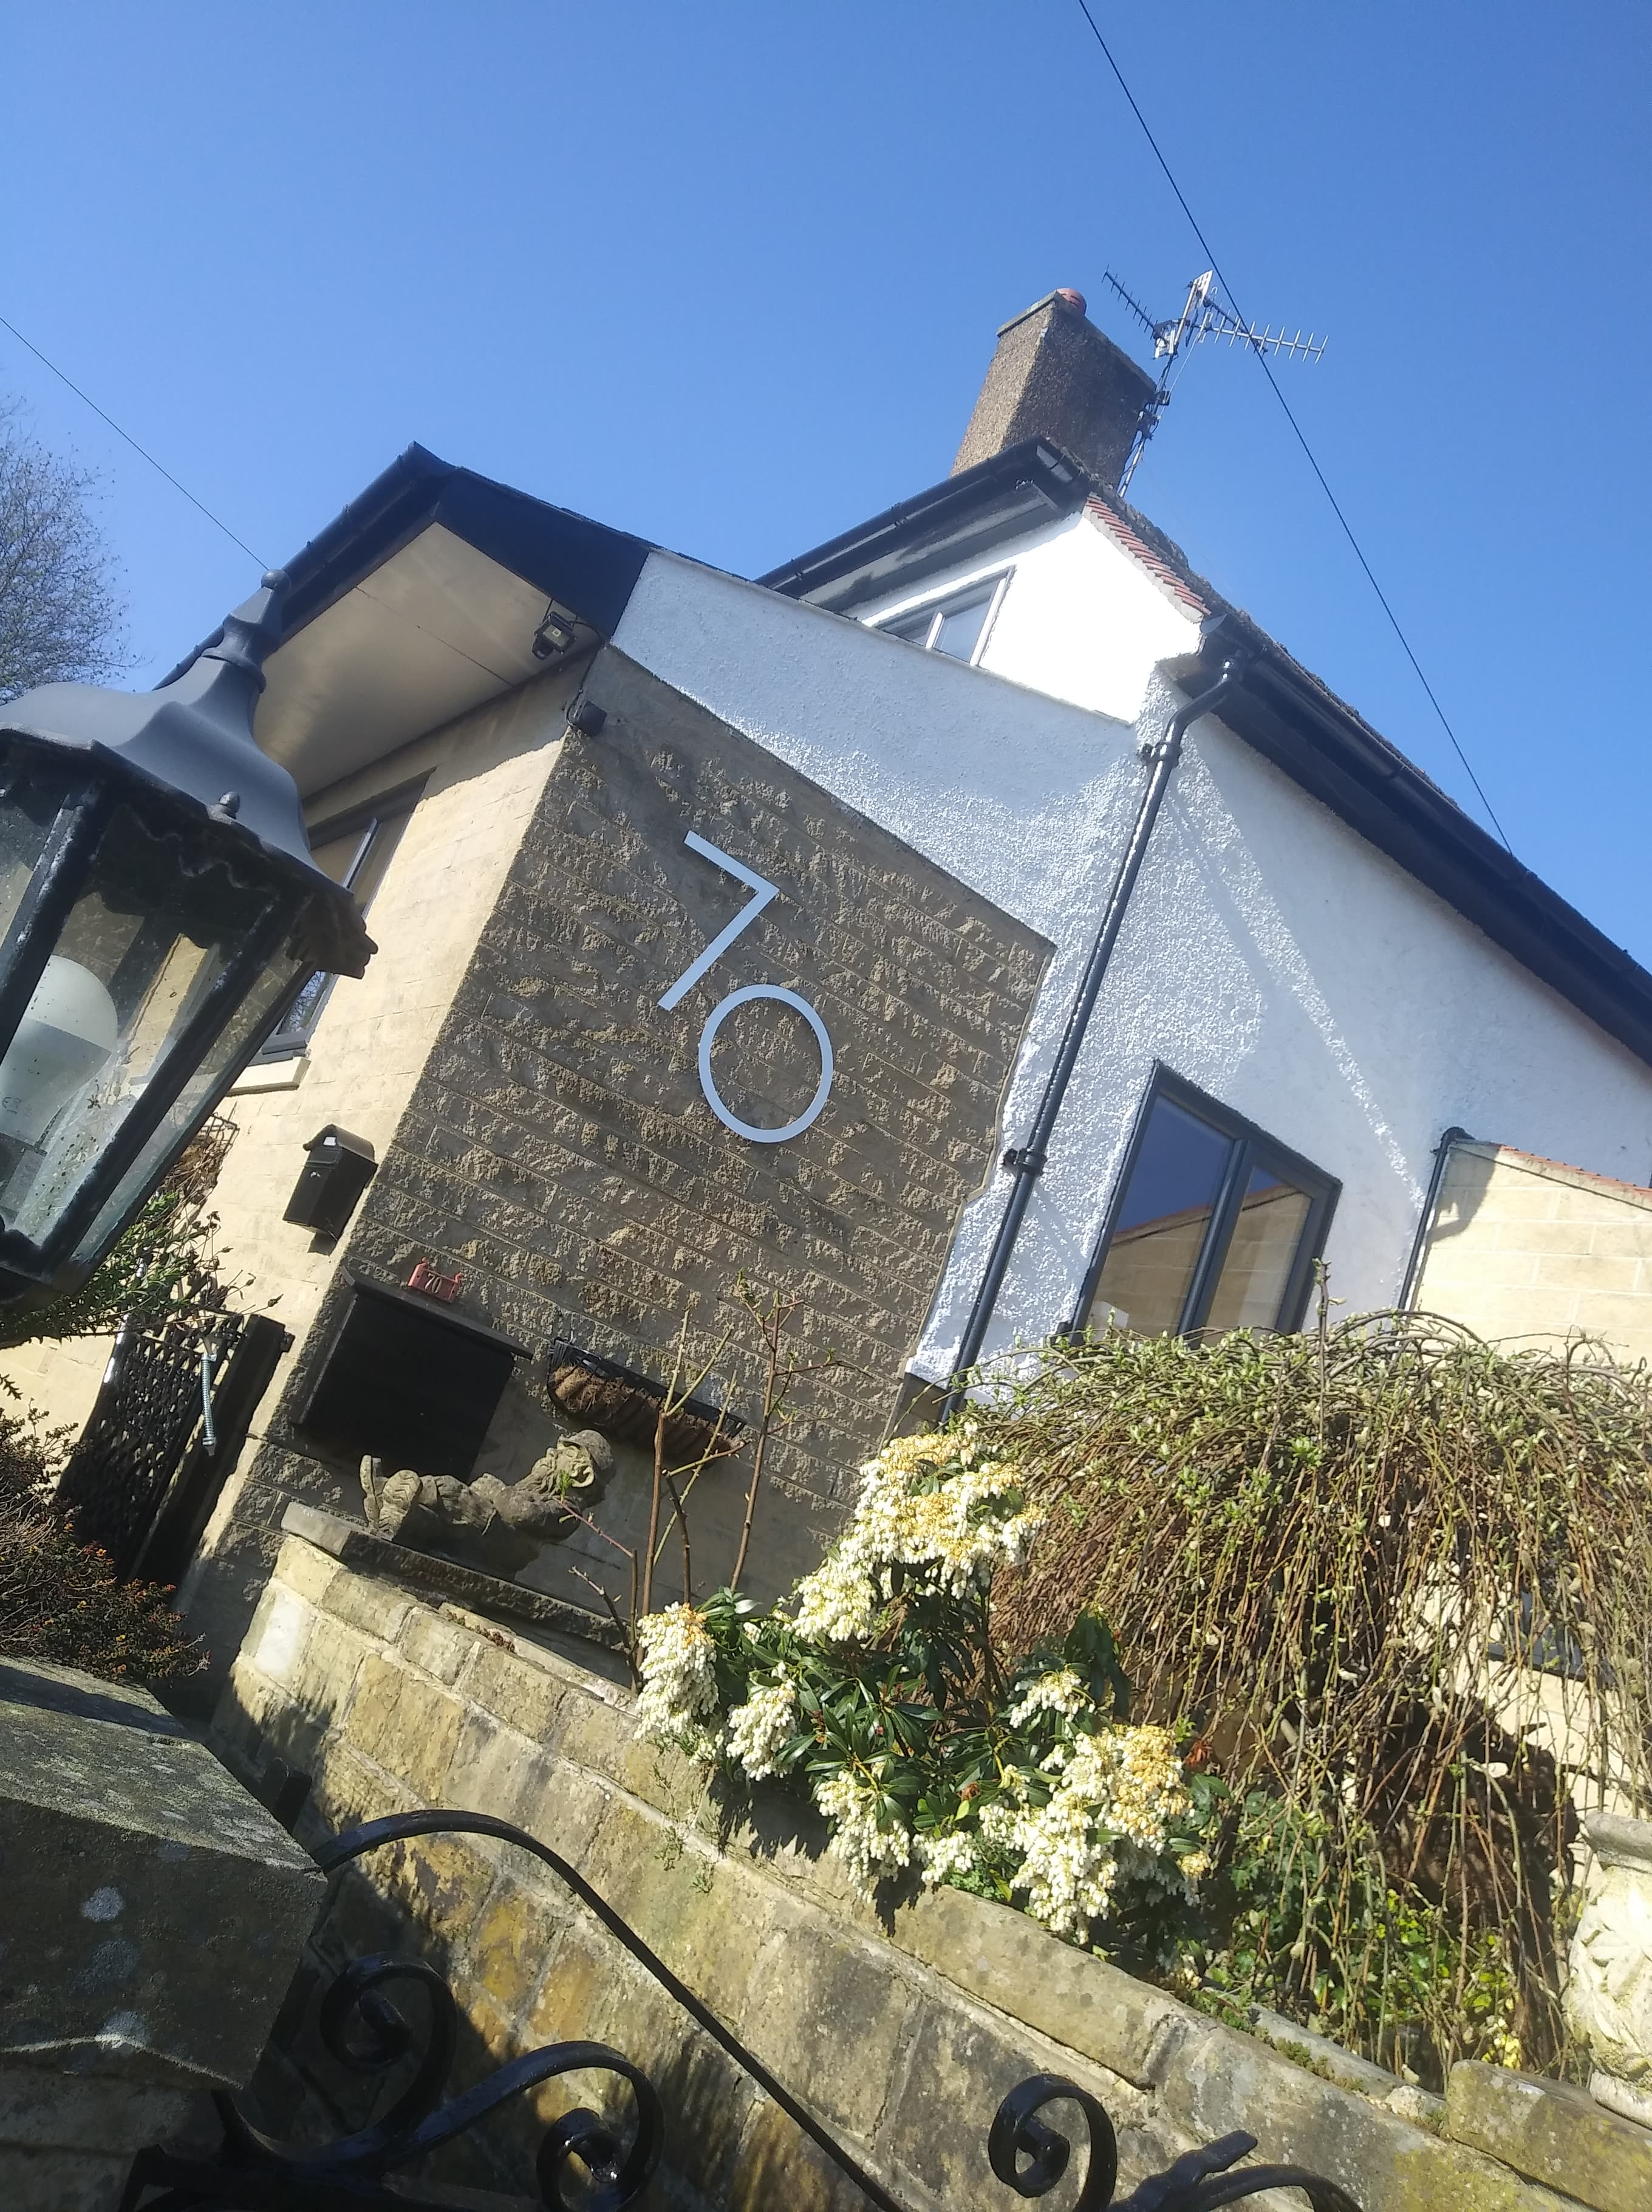


April saw our tenant’s involved in some training around living together in harmony which looks at behaviours and attitudes towards others. Here are 2 of our tenants with their certificates.
The group did an activity which looked at what actions were either good manners or bad manners and had to place their picture cards on the appropriate action. They all did a super job of understanding how our behaviours affect others.
Well done!
Silver Birches said goodbye to 2 of our tenants this month. Our wonderful team supported them in their progression to achieve independence by moving into their new home. We would like to wish them both our best wishes for the future and hope they settle well in their new home!
For all enquiries regarding available rooms please contact Nicola on 01422 419627 or alternatively you could send an email: nicola@welcomeindependentliving.co.uk
Coming Soon at Silver Birches
Next month sees us have our first Garden Fete where we hope to raise funds to help us buy items for our new sensory garden. The tenants will be doing a bake sale and there will also be prizes to be won in our Tombola. If you would like to donate new items that we could use as prizes then these can be dropped off at our Community Hub in Hebden Bridge. Thank you!
Watch this space for further info!

